Slide 1
.NET MAUI Lifecycles

Slide 2
Application Lifecycle Application
OnStart()
Method that fires when the app first starts
OnSleep()
Method that fires when the app is moved to background
OnResume()
Method that fires when the app resumes from the background

Slide 3
Page Lifecycle ContentPage
OnAppearing()
Runs when a page becomes visible
OnDisappearing()
Runs when a page disappears
OnNavigatedTo()
Runs when page is navigated to
OnNavigatingFrom()
Runs when page is navigated away from

Slide 4


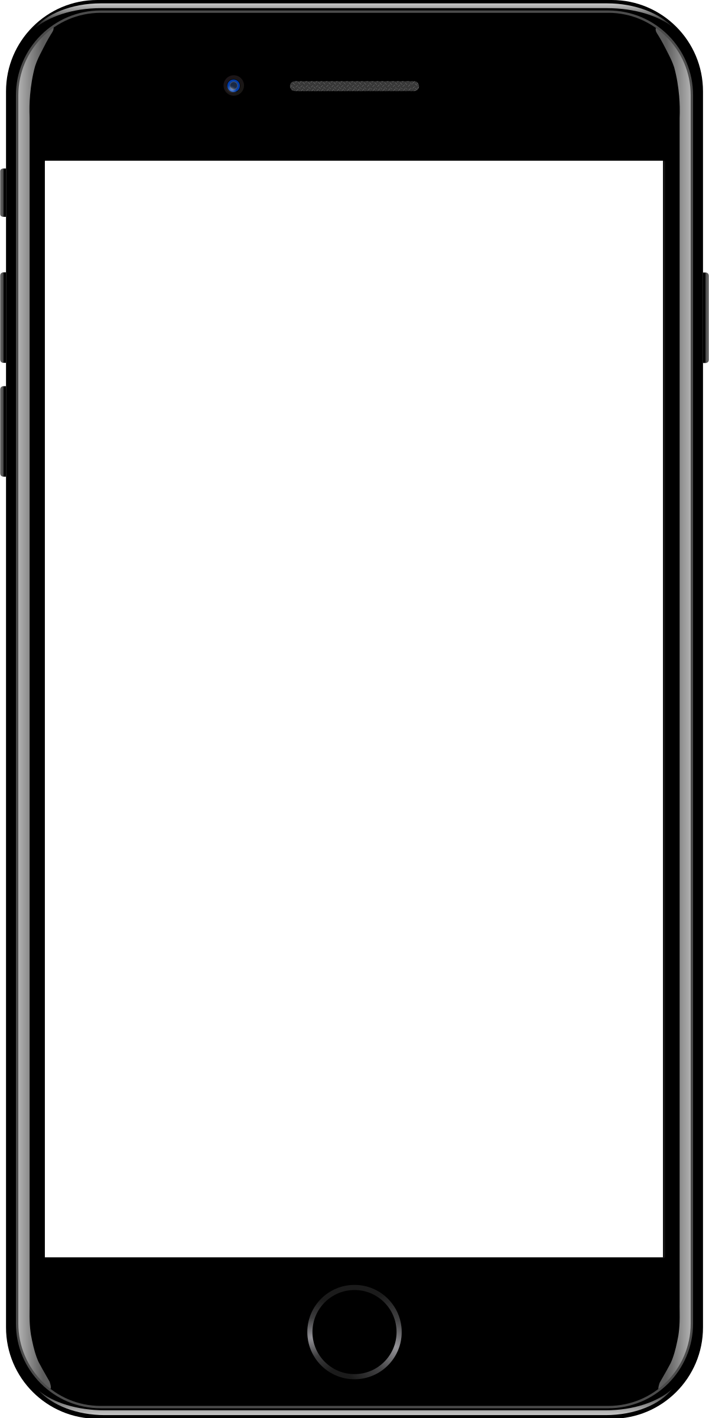
Sample mobile app slide
iPhone 7/8
iPhone 14
Generic phone
(BrandCentral)
App screenshots can be placed behind these transparent .pngs

Slide 5

Sample website slide (blank)
Website screenshots can be placed behind this transparent .png

Slide 6
Bullet points layout with subtitle Subtitle is smaller in the same text block
Example of a bulleted slide with a subhead
Set the slide title to “Sentence case”
Set subheads to “Sentence case”
Hyperlink style
www.microsoft.com

